Slide 1
ECON 101
Intro to Economic Theory

Slide 2
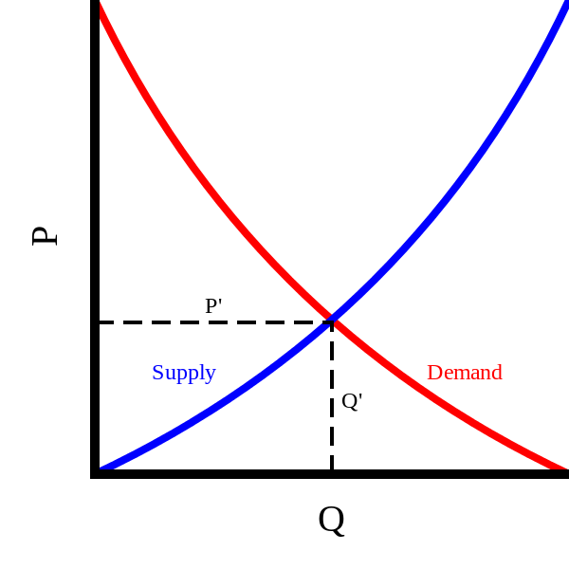
Supply and Demand
Initial market Equilibrium is at the point where supply and demand intercept
Equilibrium Quantity Q
Equilibrium Price P
This Photo by Unknown Author is licensed under CC BY-SA

Slide 3
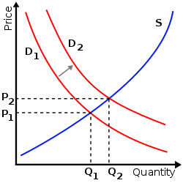
Increase in Demand
An increase in demand causes a rightward shift of the demand curve
New equilibrium is formed where S and D2 intercept
New equilibrium quantity Q2
New equilibrium price P2
This Photo by Unknown Author is licensed under CC BY-SA

